Slide 1
AVERAGE
L - 1

Slide 2
Average(Sub-Topics to be covered)
  About Average
  Important points to find the average
  Some quicker methods
  Practice Questions

Slide 3
Average
What is Average?
Average is the mean value which is equal to the ratio of the sum of the
number of a given set of values to the total number of values present in
the set. We apply an average in various areas of real life. So, Average is
defined as the sum of the observations divided by the number of
observations.
Average = Sum of observations / Number of observations

Slide 4
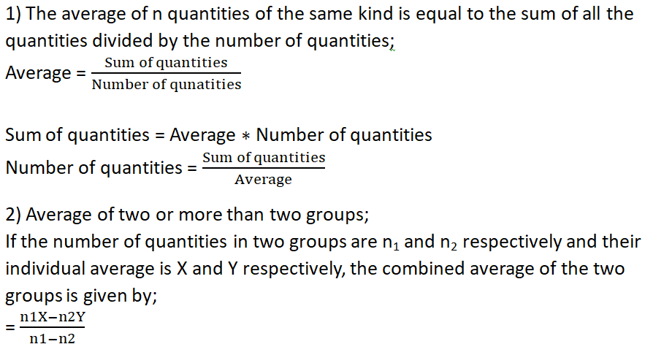
Average
Some points to remember:

Slide 5
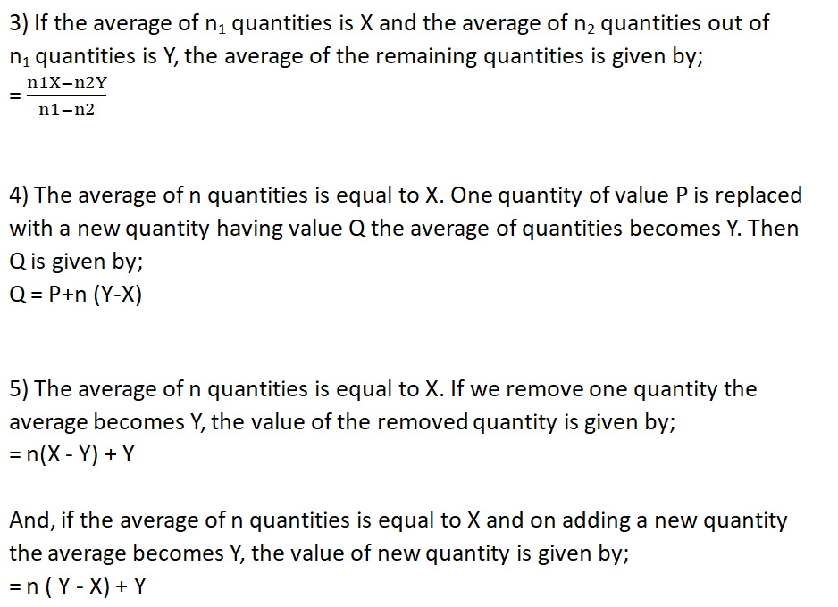
Average

Slide 6
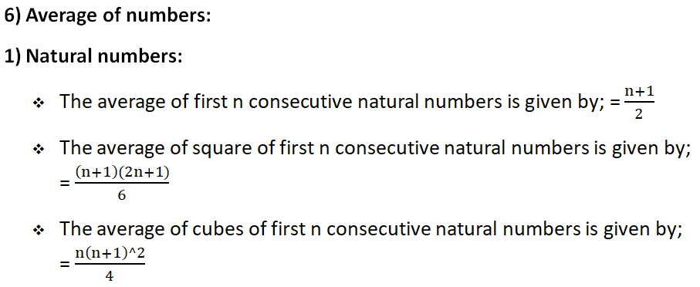
Average

Slide 7
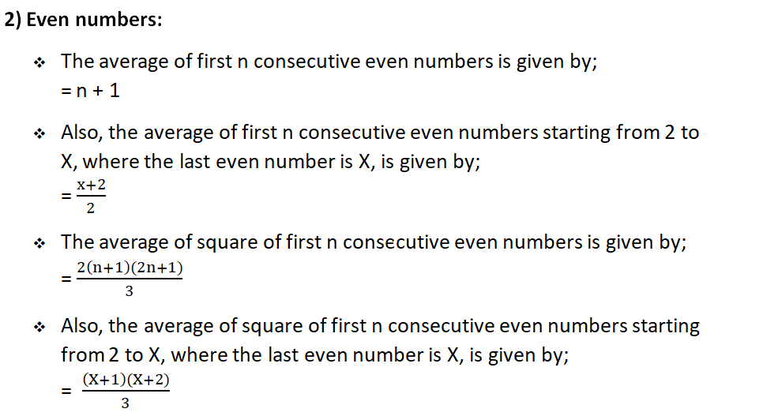
Average

Slide 8
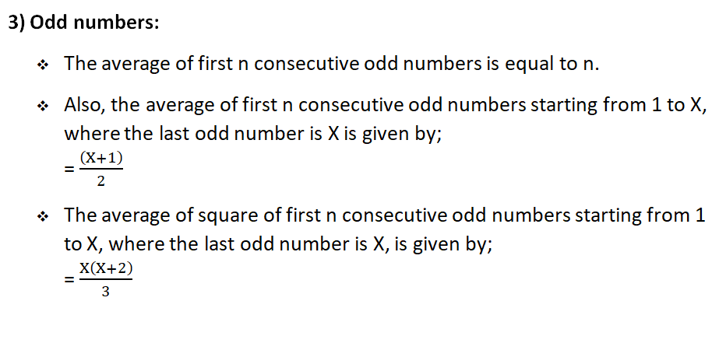
Average

Slide 9
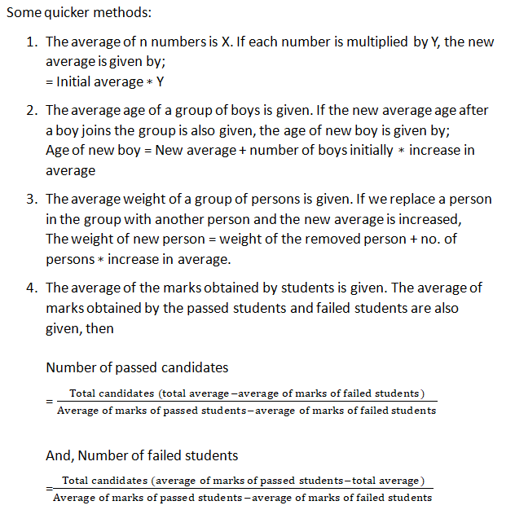
Average

Slide 10
Average
1. Find the average of the first hundred natural numbers?
50
B) 49
C) 49.5
D) 50.5
Notes:
Difficulty Level: Easy(Compulsory)
Option: D
Avg. of first 100 natural no. = [ sum of first 100 natural ] / 100 = [ n( n + 1 ) / 2 ] / 100
= n( n + 1 ) / 200 = 100(100+1)/200 = 100(101)/200 = 50.5

Slide 11
Average
2. Average of 15 consecutive even numbers is 84. Find the smallest number?
A) 50
B) 60
C) 40
D) 70
Notes:
Difficulty Level: Easy(Compulsory)
Option: D
Avg of A.P. series = middle term of series
So,
Middle term ( 8th term ) = 84
7 terms left side and 7 terms right side of middle term
Smallest even no. = 84 – 2(7) = 70

Slide 12
Average
3. Average of 12 consecutive odd numbers is 42. Find the largest number?
A) 50
B) 55
C) 53
D) 51
Notes:
Difficulty Level: Easy(Compulsory)
Option: C
Avg. of A.P. series = middle value of middle terms = 42
Middle value = 42
6 terms left side and 6 terms right side of 42
6th and 7th term are 41 and 43 respectively
Largest no. ( 12th term ) = 43 + 2(5) = 53

Slide 13
Average
4. Average of all prime numbers between 30 to 55 is:
A) 37
B) 37.8
C) 39
D) 42
Notes:
Difficulty Level: Easy(Optional)
Option: D
Prime no. between 30 to 55 = 31 , 37 , 41 , 43 , 47 , 53
Avg. = ( 31 + 37 + 41 + 43 + 47 + 53) / 6 = 252/6 = 42

Slide 14
Average
5. Find the average of first 30 odd numbers.
A)30
B) 50
C) 60
D) 45
Notes:
Difficulty Level: Moderate(Compulsory)
Correct Option: A
Sum of first n odd no. = n^2 = 900
Avg. = 900 / 30 = 30

Slide 15
Average
6. The average of 11 numbers is 32. If the average of first six numbers is 18.5 and that of last six is 43.5, then what is the sixth number?
A) 20
B) 30
C) 40
D) 25
Notes:
Difficulty Level: Easy(Compulsory)
Correct Option: A
Let the 11 no.’s are A,B,C,D,E,F,G,H,I,J,K
A+B+C+D+E+F = 18.5*6 = 111
F+G+H+I+J+K = 43.5*6 = 261
A+B+C+D+E+F+G+H+I+J+K+F = 111+261 = 372
A+B+C+D+E+F+G+H+I+J+K = 32*11 = 352
Sixth no. = F = 372 – 352 = 20

Slide 16
Average
7. 3 years ago, the average age of a family of 5 members was 17 years. A baby was born , the average age of the family is same today. The present age of the baby is
A) 4 years
B) 2 years
C) 8 years
D) 8 ½ years
Notes:
Difficulty Level: Moderate(Compulsory)
Correct Option: B
3 yrs ago, the avg. age of 5 members are 17
Then today , the avg. age of 5 members are 17+3 = 20
Sum of age of 5 members = 20*5 = 100
At present , the avg. age of 6 members = 17
Then sum of age of 6 members = 17*6 = 102
Age of 6th member = (sum of age of 6 members) – (sum of age of 5 members) = 102 – 100 = 2

Slide 17
Average
8. The average weight of 8 person's increased by 3.5 kg when a new person comes in group whose weight is 60kg. What was the average of the group in starting?
A) 18.2 kg
B) 28.5 kg
C) 27.5 kg
D) 72.5 kg
Notes:
Difficulty Level: Moderate(Compulsory)
Correct Option: B
Now the persons are 9
If avg. increased by 3.5 then total increase = 3.5*9 = 31.5
Previous avg. = 60 – 31.5 = 28.5 kg

Slide 18
Average
9. The average weight of 10 person's increased by 3.7 kg when a new person comes in group whose weight is 71 kg. What was the average of the group in starting?
A) 42.3 kg
B) 41.3 kg
C) 32.3 kg
D) 30.3 kg
Notes:
Difficulty Level: Moderate (Optional)
Correct Option: D
Now , the persons are 11
If avg. increased = 3.7
Total increased = 3.7*11 = 40.7
Original avg. = 71 – 40.7 = 30.3 kg

Slide 19
Average
10. The bowling average of a cricketer was 24.8. He improves his bowling average by 0.4 points when he takes 5 wickets for 52 runs in his last match. The number of wickets taken by him before the last match was?
165
B) 170
C) 175
D) 180
Notes:
Difficulty Level: Moderate(Compulsory)
Option: C
(24.8x+52)/(x+5) =24.4
X=175

Slide 20
Average
11. The average age of a class of 37 students is 25 years. If the age of CR is excluded, then the average decreases by 5 months. Find the age of the CR?
A) 44years
B) 40 years
C) 32 years
D) 31.5 years
Notes:
Difficulty Level: Moderate(Compulsory)
Correct option: B
Sum of age of 37 students = 37*25 = 925
Sum of age of 36 students = 36*(295/12) = 885
Age of CR = 925 – 885 = 40 years

Slide 21
Average
12. The average age of a class of 43 students is 49 years. If the age of mentor is excluded, then the average increases by 8 months. Find the age of the mentor?
A) 21 years
B) 31 years
C) 32 years
D) 11.5 years
Notes:
Difficulty Level: Moderate(Compulsory)
Correct option: A
Sum of age of 43 students = 43*49 = 2107
Sum of age of 42 students = 42*(149/3) = 2086
Age of CR = 2107 – 2086 = 21 years

Slide 22
Average
13. The average weight of A, B and C is 47 kg. If the average weight of A and B be 41 kg and that of B and C be 44 kg, then the weight of B is:
25
B) 35
C) 29
D) 39
Notes:
Difficulty Level: Easy(Compulsory)
Correct Option: C
Sum of weight of A,B,C = 47*3
A+B+C = 47*3 = 141
A+B = 41*2 = 82
B+C = 44*2 = 88
A+B+B+C = A+B+C+B= 88+82 = 170
B = 170 – 141 =29

Slide 23
Average
14. The mean of 40 observations was 49. Later on it was found that an observation 33 was wrongly taken as 58. find the corrected value of mean?
A) 48.37
B) 46.36
C) 49.12
D) 51.23
Notes:
Difficulty Level: Moderate (Optional)
Correct Option: A
Sum of 40 observation = 40*49 = 1960
Observation 33 wrongly taken as 58
Original sum = 1960 – 25 = 1935
Original mean = 1935/40 = 48.375

Slide 24
Average
15. In an exam, the average marks for 100 students of Class V is 45. The average of marks in section A of the class is 60 while the average of marks in section B is 35. Find the number of students in Class V-B?
A) 45
B) 50
C) 60
D) 70
Notes:
Difficulty Level: Moderate(Optional)
Correct Option C
Total students = 100
Let students in section A = x
Then students of section B = 100 – x
Total marks of section A = x * 60
Total marks of section B =(100 – x) * 35
Total marks of combined is 100 * 45 = 4500
60x + 35(100 – x) = 4500
60x + 3500 – 35x = 4500
25x = 1000
X = 40
Students of section B = 100 – x = 100 – 40 = 60

Slide 25
Average
16. The average temperature of Delhi in the first four days of June 2017 was 52 degrees. The average for the second, third, fourth and fifth days was 55 degrees. If the temperatures of the first and fifth days were in the ratio 5 : 7, then what was the temperature of Delhi on 5th June 2017?
A) 36 degree
B) 30 degree
C) 48 degree
D) 42 degree
Notes:
Difficulty Level: Expert (Optional)
Option D
um of temperature on 1st, 2nd, 3rd, and 4th days = (52 × 4) = 208----------(I)
Sum of temperature on 2nd, 3rd, 4th, and 5th days = (55 × 4) = 220---------(II)
Subtracting equation (I) from (II)
Temperature on 5th June 2017 – temperature on 1st June 2017 = 12 degrees.
Let the temperature on 1st and 5th June 2017 be 5x and 7x degrees respectively.
Then, 7x – 5x = 12
2x = 12
X = 6
Since temperature on the 5th June 2017 in Delhi = 7x = 7 × 6 = 42 degrees.

Slide 26
Average
17. There are two batches A and B of a class. Batch A consists of 38 students and batch B consists of 42 students. Find the average weight of whole class, if average weight of batch A is 40 kg and that of batch B is 35 kg?
A) 29.23 kg
B) 32.576 kg
C) 35.66 kg
D) 37.375 kg
Notes:
Difficulty Level: Moderate(Compulsory)
Correct Option: D
Total weight of batch A = 38*40
Total weight of batch B = 42*35
Sum of all = (38*40) + (42*35) = 2990
Combined avg. = 2990 / 80 = 37.375 kg

Slide 27
Average
18. The average of eight numbers is x and the average of four of these is y. If the average of the remaining four is z, then
A) x = y + z
B) 2x = y + z
C) x = 2y + z
D) x = y + 2z
Notes:
Difficulty Level: Easy(Compulsory)
Option: B
Sum of 8 no. = 8x
Sum of 4 no.’s = 4y
Sum of remaining 4 no.’s = 8x – 4y
Average of remaining 4 no.’s = (8x – 4y) / 4 = 2x – y = z
2x = y + z

Slide 28
Average
19. The average monthly income of P and Q is Rs. 5150. The average monthly income of Q and R is Rs. 6250 and the average monthly income of P and R is Rs. 5250. The monthly income of P is:
4150
B) 3400
C) 4250
D) None of these
Notes:
Difficulty Level: Easy(Optional)
Correct Option: A
Let P, Q and R represent their respective monthly incomes. Then, we have:
P+Q=(5150×2)=10300....(i)
Q+R=(6250×2)=12500.....(ii)
P+R=(5250×2)=10500....(iii)
Adding (i), (iii) and (iii), we get: 2(P+Q+R)=33300 or P+Q+R=16650...(iv)
Subtracting (ii) from (iv), we get P=4150.
∴ P's monthly income =Rs.4150.

Slide 29
Average
20. There are some history books and some geography books in a library. The books that were read cover to cover. The average number of pages read for all these books is 160. If the average number of pages read for history books is 164 and that for geography books is 150, find the ratio of no. of history books to that of geography books.
A) 5:2
B) 2:5
C) 3:5
D) 5:3
Notes:
Difficulty Level: Moderate(Compulsory)
Correct Option A
Let the number of history books be x and the number of geography books be y
Average no. of pages in history books = 164
Total pages in history books = 164x
Average no. of pages in geography books = 154
Total pages in geography books = 150y
Total pages both in history and geography books combined
= 164x + 150y
Average number of pages both in history and geography books combined
= (164x + 150y)/(x+y) = 160
164x + 150y = 160x + 160y
4x = 10y
x/y = 10/4 = 5/2 = 5 : 2

Slide 30
Average
21. Raja carried two types of pens with him. The ratio of cost of Pen A to Pen B was 12:5. There were two pens of type B with him and one pen of type A .The average cost of all the three pens together was Rs 110. Find the cost of Pen A?
A) Rs 72
B) Rs 75
C) Rs 160
D) Rs 180
Notes:
Difficulty Level: Moderate(Optional)
Correction Option: D
Pen A is one and pen B is two
Ratio of cost of A:B = 12:5
Ratio of amount of A:B = 12:5(2) = 12:10 = 6 : 5
There are total 3 pens
Avg of all = 110
Amount of all = 110 * 3 = 330
6x + 5x = 330
11x = 330
X = 30
Pen A amount = 6x = 180

Slide 31
Average
22. Akshit sold 21 tables in a day. He told his father, "My earnings at end of the day are Rs 450000/-. The average earning from the first 11 tables I sold was Rs 25000/-". What were his average earnings from the remaining tables?
A) Rs. 9125
B) Rs. 17500
C) Rs. 16,363
D) Rs. 18,000
Notes:
Difficulty Level: Moderate(Compulsory)
Correct Option: B
Total earning of 21 tables = 450000
Earning of first 11 tables = 25000*11 = 275000
Earning of remaining 10 tables = 450000 – 275000 = 175000
Avg. = 175000/10 = 17500

Slide 32
Average
23. A library has an average of 550 visitors on Sundays and 280 on other days. The average number of visitors per day in a month of 30 days beginning with a Sunday is:
225
B) 235
C) 325
D) 345
Notes:
Difficulty Level: Moderate (Optional)
Correct Option: C
If month is starting from Sunday
Then there is 5 sundays and remaining 25 other days
No. of visitors in 5 sundays = 550*5 = 2750
No. of visitors on other days = 280*25 = 7000
Combined avg of visitors in a month = (7000+2750) / 30 = 9750/30 = 325

Slide 33
Average
24. If I do not consider the earnings from selling the six seater dining table, my average falls by Rs 2000/-. What is the cost of six seater dining table if average earnings from selling 11 four seater dining tables and one six seater dining table is Rs 18000?
A) Rs. 29000
B) Rs. 37000
C) Rs. 36000
D) Rs. 40000
Notes:
Difficulty Level: Moderate (Optional)
Correct Option: D
Without six seater dining table, there are 11 four seater dining tables.
Average = 18000 - 2000 = 16000.
Total cost of 11 small dining tables = 11 x 16000 = Rs. 176000
With big dining table, total cost of 12 tables = 12 x 18000 = Rs. 216000
Cost of six seater dining table = 216000 - 176000 = Rs. 40000

Slide 34
Average
25. A student finds the average of ten 2-digit numbers. By mistake, he writes one number with its digits interchanged. As a result his average is 2.7 less than the correct average. The difference of the digits of the number, in which he made mistake, is
A) 2
B) 3
C) 4
D) 5
Notes:
Difficulty Level: Expert(Compulsory)
Option: B
(10x+y)-(10y+x)/10 =2.7
9(x-y) =27
X-y= 3

Slide 35
Average
26. Mahima bought 20 kg pasta for Rs 30 per kg, m kg pasta for Rs 35 per kg and (m + 4) kg pasta for Rs 25 per kg. She mixed all type of pasta together and the average cost price of 1 kg pasta is Rs 29.6. Find the quantity of pasta that is bought at Rs 25 per kg.
12 KG
B) 20 KG
C) 13 KG
D) 17 KG
Notes:
Difficulty Level: Expert (Optional)
Correct Option: D
20 × 30 + m × 35 + (m + 4) × 25 = 29.6 × (20 + m + m + 4)
600 + 35m + 25m + 100 = 29.6 × (24 + 2m)
700 + 60m = 710.4 + 59.2m
710.4 – 700 = 60m – 59.2m
10.4 = 0.8m
m = 13
Quantity of pasta that is bought at Rs 25 per kg = 13 + 4 = 17 kg

Slide 36
Average
27. In Varun's opinion, his weight is greater than 64 kg but less than 71 kg. His brother does not agree with Varun and he thinks that Varun's weight is greater than 61 kg but less than 69 kg. His mother's view is that his weight cannot be greater than 67 kg. If all are them are correct in their estimation, what is the average of different probable weights of Varun?
A) 95
B) 75
C) 60
D) 66
Notes:
Difficulty Level: Expert (Optional)
Correct Option: D
Required average =66

Slide 37
Average
28. If average weight of a family is ‘y’ kg. If a guest weighing 30 kg arrives then the average weight is increased by 1 kg. If the weight of this guest had been 18 kg then the average weight of the family would have decreased by 1 kg. Find ‘y’.
A) 28.
B) 24.
C) 30.
D) 22
Notes:
Difficulty Level: Expert(Optional)
Correct option: B
Let the number of family members be x.
Therefore, the total weight = xy
Equation in the 1st scenario:
(x + 1) (y + 1) = xy + 30
xy + x + y + 1 = xy + 30
x + y = 29 .....(i)
Equation in the 2nd scenario:
(x + 1) (y - 1) = xy + 18
xy + y - x - 1 = xy + 18
y - x = 19 ....(ii)
Solving equtions (i) and (ii), we get
2y = 48, Therefore, y = 24.

Slide 38
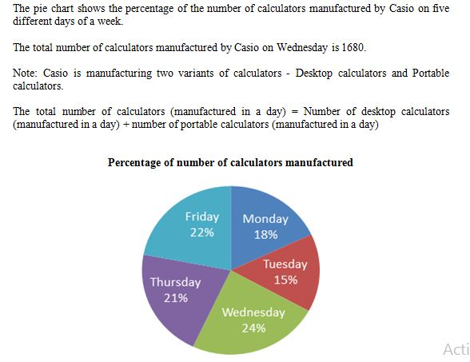
Average
Directions: Study the following pie chart carefully and answer the questions given beside.
29. Find the average of the number of calculators manufactured by Casio on Monday, Tuesday and Wednesday together?
A) 1330
B) 1470
C) 1540
D) 1260
Notes:
Difficulty Level: Moderate(Compulsory)
Correct Option: A
24%=1680
1%= 70
57% =57*70=3990
Required Average= 3990/3=1330

Slide 39
Average
Directions: Study the following pie chart carefully and answer the questions given beside.
30. If the ratio of the number of Desktop calculators to the number of Portable calculators manufactured on Friday is
7 : 4, respectively then the number of Desktop calculators manufactured on Friday is what percentage of the number of calculators manufactured on Tuesday?
A) 83.33%
B) 93.33%
C) 57.5%
D) None of these
Notes:
Difficulty Level: Moderate (Optional)
Correct Option: B
Total no. of calculators manufactured on Friday= (1680/24)*22= 1540
No of desktop calculators manufactured on Friday= (7/11)*1540= 980
No of calculators manufactured on Tuesday= 15*70=1050
Required %= (980/1050)*100= 93.33%

Slide 40
Any Doubts???

